Slide 1


Presented By
S.M Mahamudul Hasan
2016331032
Nirjas Mohammad Jakilim
2016331101
Fake News Detection
in Bangla Language
Supervisor
Enamul Hassan
Assistant Professor
Department of
Computer Science & Engineering

Slide 2
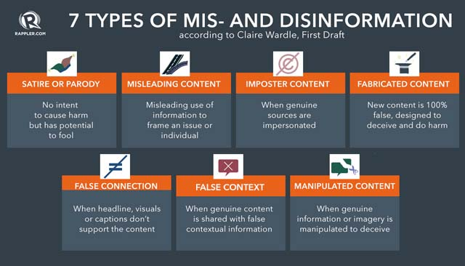
WHAT IS FAKE NEWS?
Fake news is false or misleading information presented as news. (Wikipedia)
2

Slide 3
WHY FAKE NEWS DETECTION?
Rapid spread of fake news should be stopped.
An automated system is needed. Because,
Human checking is too inefficient and time consuming.
Available websites (jaachai.com, bdfactcheck.org, fact-watch.org) also use human efforts.
3

Slide 4

PREVIOUS Work
Present work
Added more fake and reduced true news to balance the dataset.
Performed character-based embedding to compare with word based embedding performances.
Evaluated deep learning models like RNN and LSTM with word2vec and One hot vector.
Evaluated pre-trained BERT model.
Extended Dataset
Exploratory Data Analysis of the dataset
Evaluated traditional models with frequency based word embedding models.
4

Slide 5
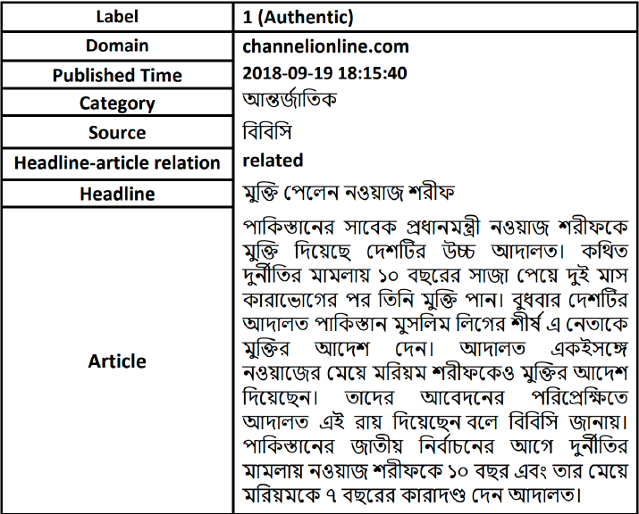
Dataset
Dataset Features
Collected Fake News dataset from Kaggle.
Added more fake news and slightly balanced it with the true news.
7

Slide 6



Dataset
11434
10000
1434
Total
True
Fake
 | Total | Characters | Punctuations | Words | Sentence
Authentic | 10000 | 1482.87 | 41.30 | 271.99 | 21.21
Fake | 1434 | 1560.12 | 43.69 | 278.42 | 23.82

Slide 7
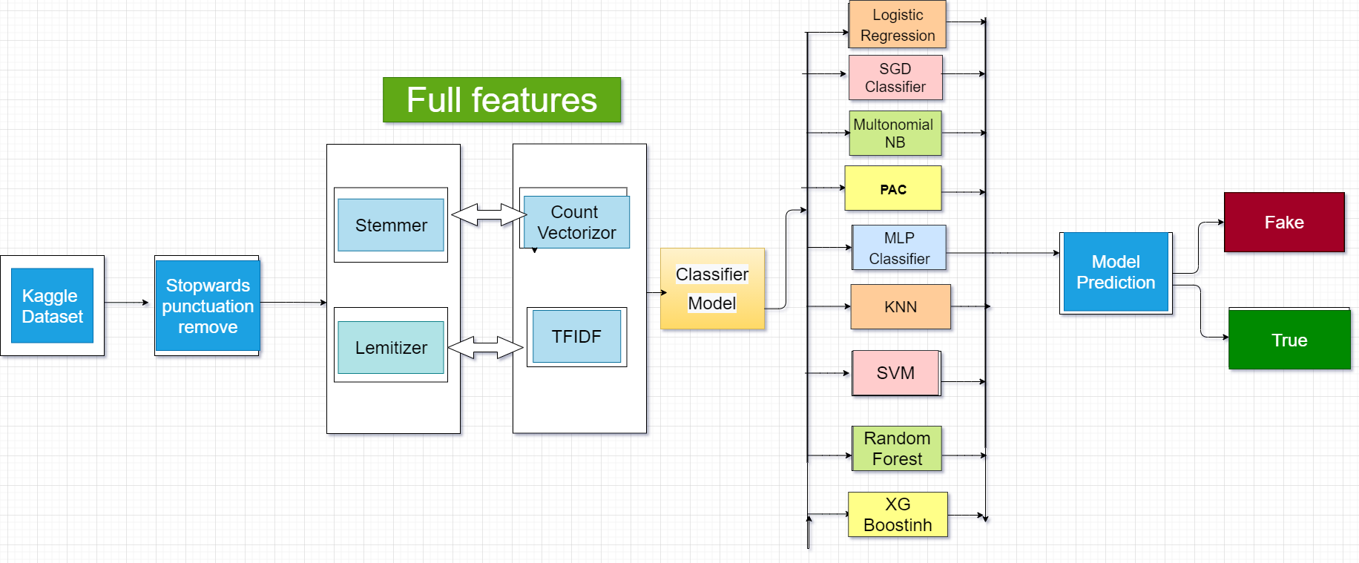
Our Approach for Traditional Models

Slide 8
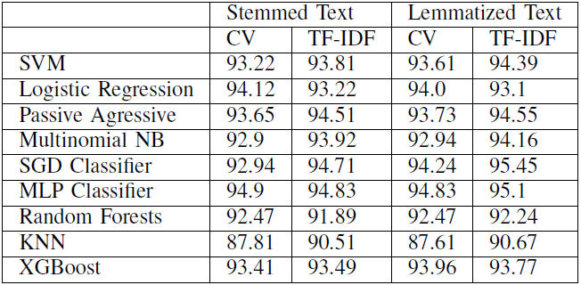
Performances of the Models
8

Slide 9
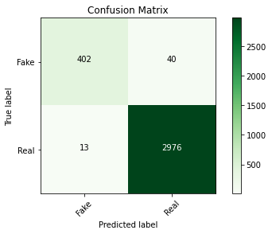
SVM with Char-Based TF-IDF
Evaluated SVM with character based embedding.
Got much improved result than word-based embedding and the accuracy is 98.45% accuracy.
SVM with Char-Based Embedding
10

Slide 10

PAC with Char-Based TF-IDF
Passive Aggressive Classifier also shows improved performance for character based embedding.
Got 98.39% Accuracy.
PAC with Char-Based Embedding
10

Slide 11

MLP with Char-Based TF-IDF
Evaluated MLP Neural Network classifier with character based embedding.
Got 98% accuracy.
MLP with Char-Based Embedding
10

Slide 12
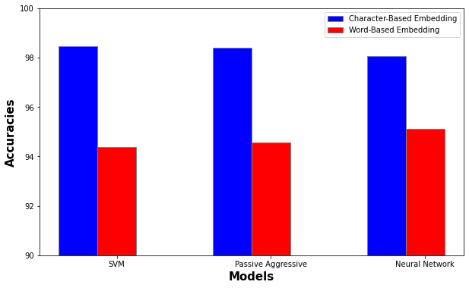
Performance breakdown for word based and char-based models
Fig : Performance breakdown of the models
13

Slide 13
Experiments with Deep Learning Models
Key Informations
Headline and Body text are the features.
One Hot Vectors and pre-trained bengali word2vec are used as the word embedding method
70% of the dataset for training and 30% for primary evaluation.
LSTM, RNN and BERT is used for classification.
9

Slide 14
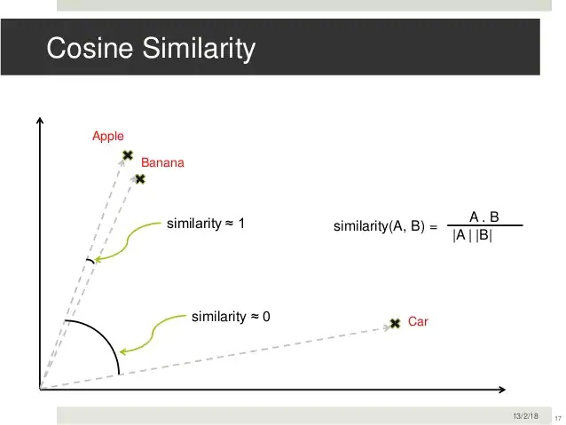
Word2vec
Continuous Bag of Words
skip-gram
Cosine Similarity
10

Slide 15
Wor2vec (Cont.)
Used gensim library to generate our own model
Used pre-trained bengali word2vec model taken from github https://github.com/rezacsedu/Classification_Benchmarks_Benglai_NLP
10

Slide 16
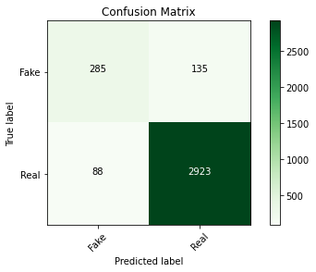
LSTM with One Hot Vector
Evaluated first on the stemmed text.
Got an accuracy of 93.5%
LSTM with One Hot Vector on Stemmed Text
10

Slide 17
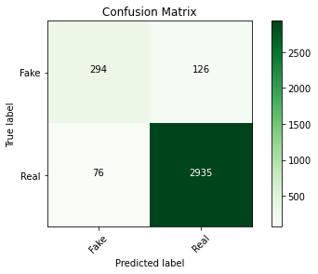
LSTM with One Hot Vector (Cont.)
Evaluated on the lemmatized text with same parameters.
Got an accuracy of 94.11%
LSTM with One Hot Vector on Lemmatized Text
10

Slide 18
LSTM with Word2vec
Evaluated LSTM on pre-trained word2vec model.
Used 100 dimensional word vectors.
1D-CNN with Relu activation used.
Got an accuracy of 94.5%
LSTM with Word2vec
10

Slide 19
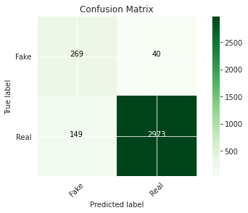
LSTM with Bangla Glove Vector
Evaluated LSTM on pre-trained bengali Glove vector.
Used 100 dimensional word vectors.
Relu and Sigmoid used as activation
function
Got 94.49% accuracy.
LSTM with Glove
10

Slide 20
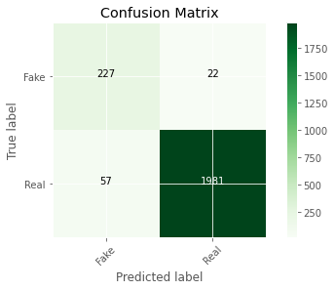
RNN
Evaluated Recurrent Neural Network Model.
Used Bidirectional LSTM layers.
Relu used as activation function
Got 96.55% accuracy on 10 epochs.
RNN Confusion Matrix
10

Slide 21
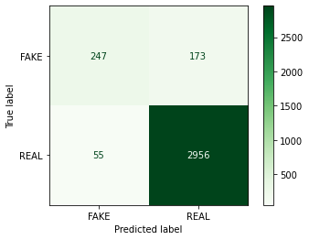
Pre-trained Bangla BERT
Evaluated the Pre-trained BERT Model
Used custom vocabularies.
Got 93.35% accuracy on 3 epochs.
BERT Confusion Matrix
10

Slide 22
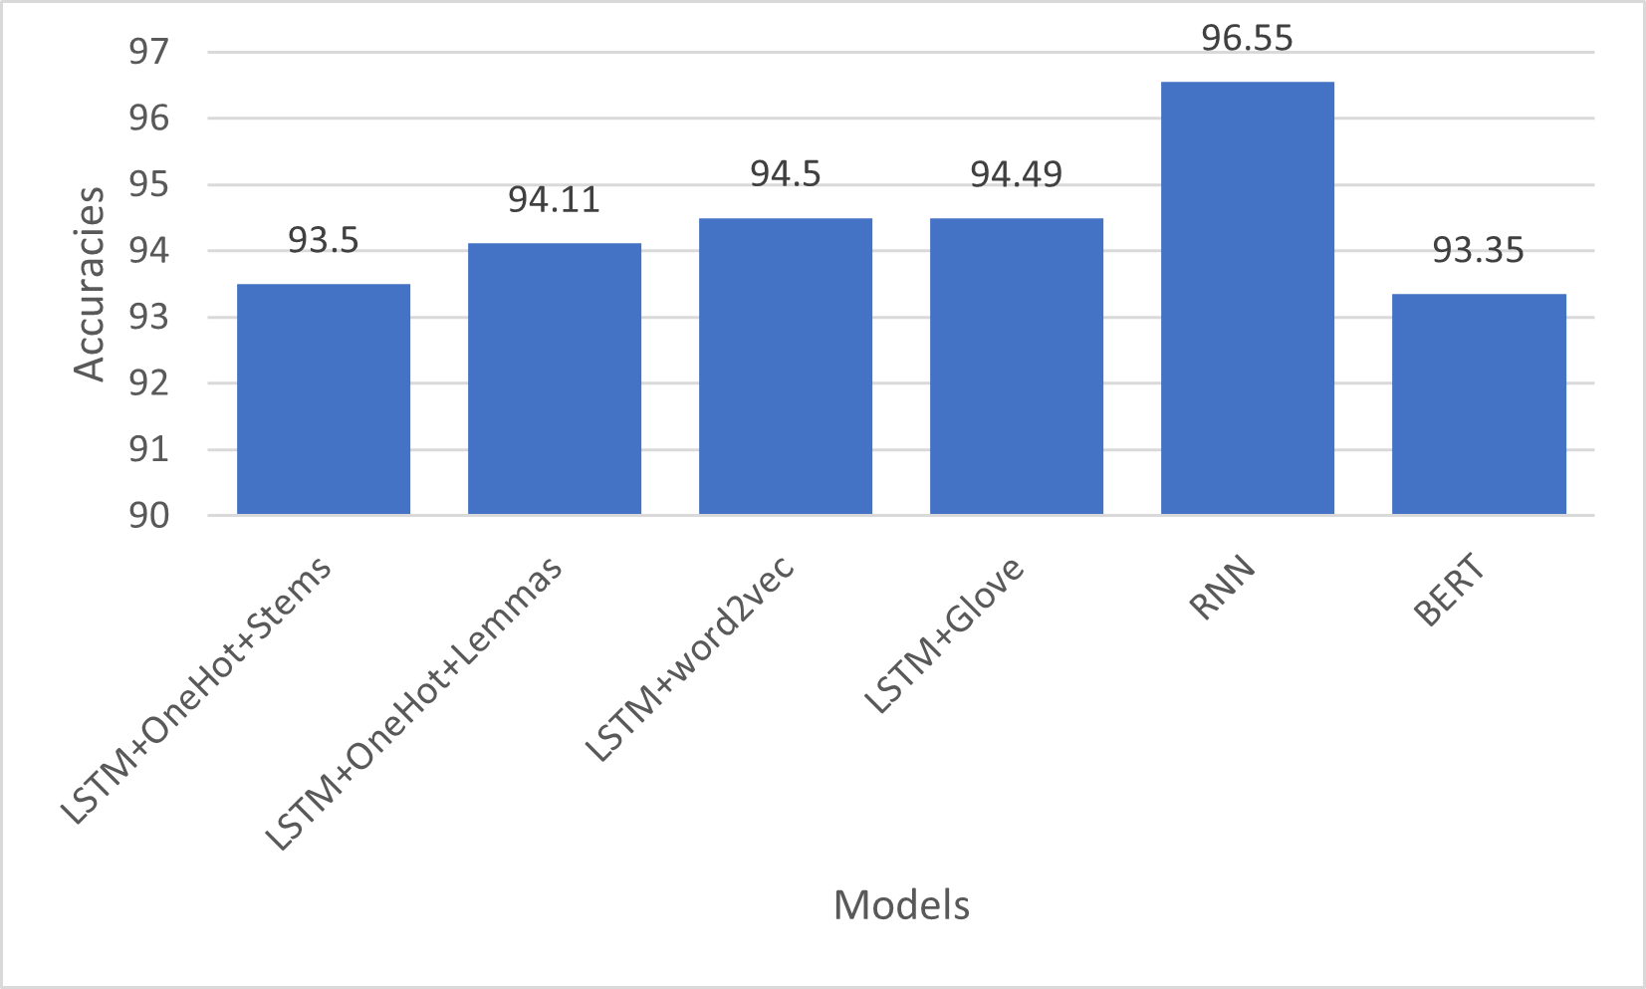
Results for deep learning models
Fig : Accuracies against Deep Learning Models
13

Slide 23
Conclusion
Lemmatized text performs well for word embedding methods.
Character-Based embedding method performs better than word-based embedding methods in case of fake news.
Deep learning models can’t significantly improves the performance may be due to dataset size.
14

Slide 24
Thank You

Slide 25
Questions and Suggestions ?

